Slide 1
Hidden Markov Model
Il-Chul Moon Dept. of Industrial and Systems Engineering KAIST
icmoon@kaist.ac.kr

Slide 2
Weekly Objectives
Learn hidden Markov model
Transition from the static clustering to the dynamic clustering
Understand the difference of the graphical model
Know and able to answer the three major questions of HMM
Know how to solve the evaluation question
Know how to solve the decoding question
Know how to solve the learning question
Link to the previous lectures
Link the forward-backward algorithm to the message passing
Link the baum-welch algorithm to the EM algorithm

Slide 3
Hidden Markov Model

Slide 4





Time Series Data for GMM
$$π$$
z
Imagine the following case
Data points on the plane
Have a temporal trace of data points
Now, any broken assumption in the analysis?
Any real world applications
Many, many, many…
Stock market analysis, text mining…
$$μ$$
$$Σ$$
x
N
KOSPI
Related…
DJIA
Related…

Slide 5





What to Model and How to Model
$$π$$
z
Previously, all data points are independent trials
Now, they are not any further
Temporal relation: causality from time t to time t+1
Overall trend: latent state variables
$$μ$$
$$Σ$$
x
N
$$π$$
Initial State Prob
Latent Variables
z1
z2
z3
$$π$$
z1
z2
z3
x1
x2
x3
x1
x2
x3
Temporal Causality

Slide 6

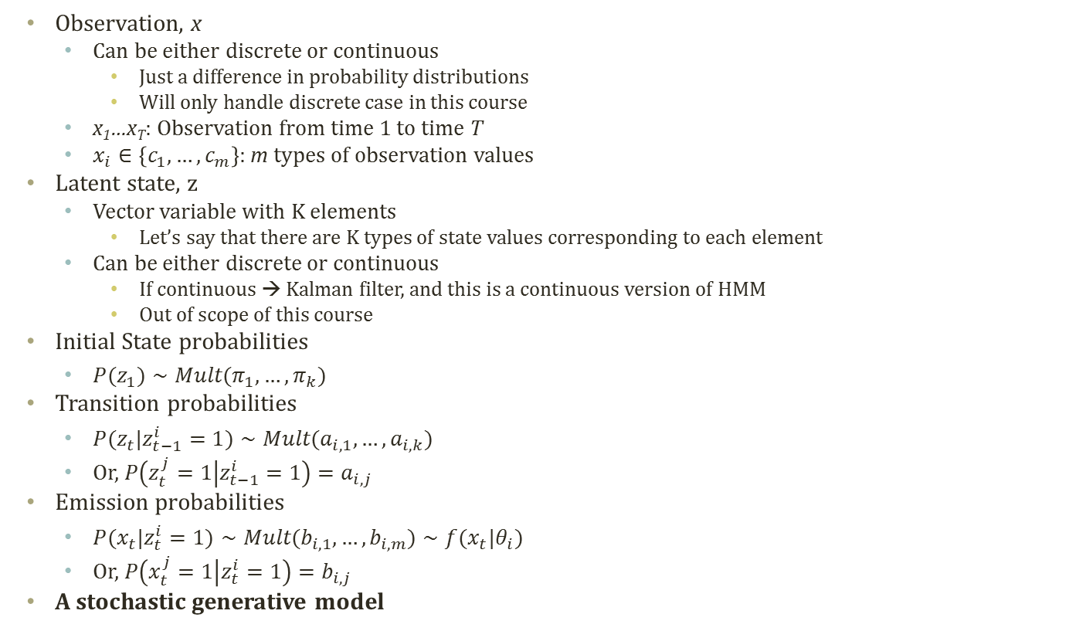
Hidden Markov Model
Observation, x
Can be either discrete or continuous
Just a difference in probability distributions
Will only handle discrete case in this course
x₁…x_{T}: Observation from time 1 to time T
$x_{i}∈\left\{c_{1},…,c_{m}\right\}$: m types of observation values
Latent state, z
Vector variable with K elements
Let’s say that there are K types of state values corresponding to each element
Can be either discrete or continuous
If continuous → Kalman filter, and this is a continuous version of HMM
Out of scope of this course
Initial State probabilities
$P(z_{1})∼Mult(π_{1},…,π_{k})$
Transition probabilities
$P(z_{t}|z_{t−1}^{i}=1)∼Mult(a_{i,1},…,a_{i,k})$
Or, $P\left(z_{t}^{j}=1 | z_{t−1}^{i}=1\right)=a_{i,j}$
Emission probabilities
$P(x_{t}|z_{t}^{i}=1)∼Mult(b_{i,1},…,b_{i,m})∼f(x_{t}|θ_{i})$
Or, $P\left(x_{t}^{j}=1 | z_{t}^{i}=1\right)=b_{i,j}$
A stochastic generative model
$$π$$
z1
z2
z3
x1
x2
x3
2
2
1
A
B
1
2
C
D
2
1
1

Slide 7

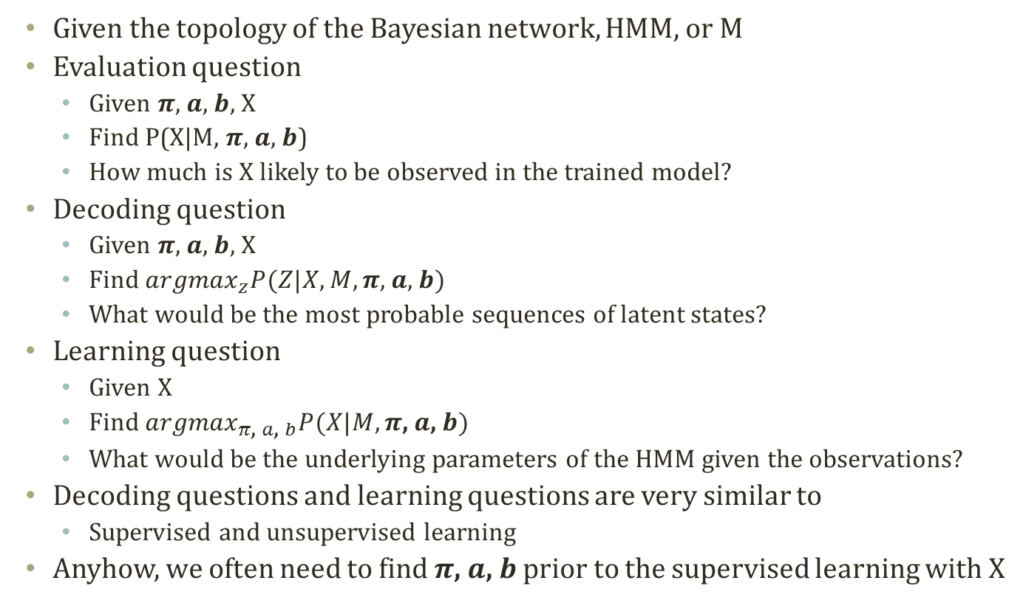
Main Questions on HMM
Initial State probabilities
$$P(z_{1})∼Mult(π_{1},…,π_{k})$$
Transition probabilities
$$P(z_{t}|z_{t−1}^{i}=1)∼Mult(a_{i,1},…,a_{i,k})$$
Or, $P\left(z_{t}^{j}=1 | z_{t−1}^{i}=1\right)=a_{i,j}$
Emission probabilities
$$P(x_{t}|z_{t}^{i}=1)∼Mult(b_{i,1},…,b_{i,m})∼f(x_{t}|θ_{i})$$
Or, $P\left(x_{t}^{j}=1 | z_{t}^{i}=1\right)=b_{i,j}$
Given the topology of the Bayesian network, HMM, or M
Evaluation question
Given $π$, $a$, $b$, X
Find P(X|M, $π$, $a$, $b$)
How much is X likely to be observed in the trained model?
Decoding question
Given $π$, $a$, $b$, X
Find ${argmax}_{z}P(Z|X,M,π\text{, }a\text{, }b)$
What would be the most probable sequences of latent states?
Learning question
Given X
Find ${argmax}_{π\text{, }a\text{, }b}P(X|M,π\text{, }a\text{, }b)$
What would be the underlying parameters of the HMM given the observations?
Decoding questions and learning questions are very similar to
Supervised and unsupervised learning
Anyhow, we often need to find $π\text{, }a\text{, }b$ prior to the supervised learning with X

Slide 8
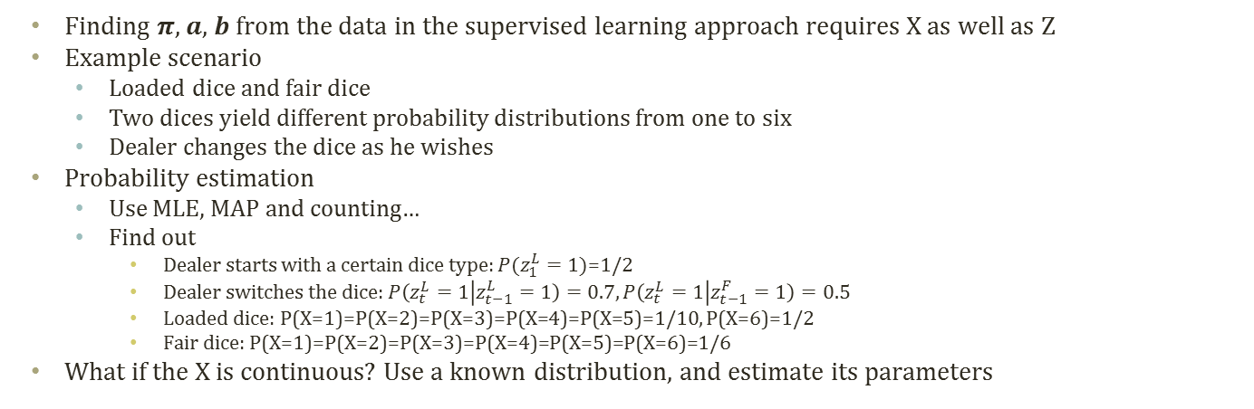


Obtaining $π$, $a$, $b$ given X and M
Initial State probabilities
$$P(z_{1})∼Mult(π_{1},…,π_{k})$$
Transition probabilities
$$P(z_{t}|z_{t−1}^{i}=1)∼Mult(a_{i,1},…,a_{i,k})$$
Or, $P\left(z_{t}^{j}=1 | z_{t−1}^{i}=1\right)=a_{i,j}$
Emission probabilities
$$P(x_{t}|z_{t}^{i}=1)∼Mult(b_{i,1},…,b_{i,m})∼f(x_{t}|θ_{i})$$
Or, $P\left(x_{t}^{j}=1 | z_{t}^{i}=1\right)=b_{i,j}$
LLLLLLLFFFFFFFF
12342531643242
……………
FFFLLFLFLFLLLLFLLLFL
3526152436152436152
Counting, MLE, MAP…
$$π$$
z1
z2
z3
N
seq.
x1
x2
x3
M_{i} observations for i-th sequence
Finding $π$, $a$, $b$ from the data in the supervised learning approach requires X as well as Z
Example scenario
Loaded dice and fair dice
Two dices yield different probability distributions from one to six
Dealer changes the dice as he wishes
Probability estimation
Use MLE, MAP and counting…
Find out
Dealer starts with a certain dice type: $P(z_{1}^{L}=1)\text{=1/}\text{2}$
Dealer switches the dice: $P\left(z_{t}^{L}=1 | z_{t−1}^{L}=1\right)=0.7,P\left(z_{t}^{L}=1 | z_{t−1}^{F}=1\right)=0.5$
Loaded dice: P(X=1)=P(X=2)=P(X=3)=P(X=4)=P(X=5)=1/10, P(X=6)=1/2
Fair dice: P(X=1)=P(X=2)=P(X=3)=P(X=4)=P(X=5)=P(X=6)=1/6
What if the X is continuous? Use a known distribution, and estimate its parameters

Slide 9

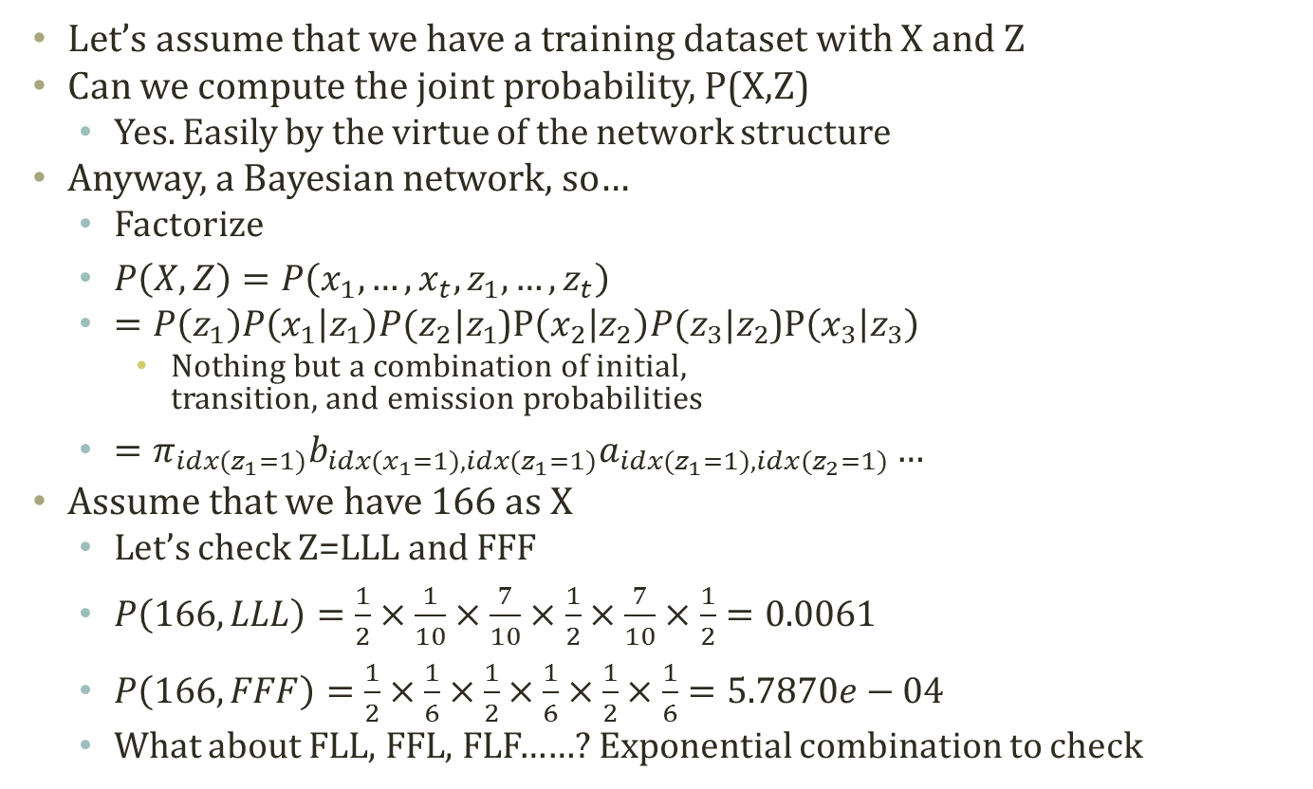

Joint Probability
Initial State probabilities
$$P(z_{1})∼Mult(π_{1},…,π_{k})$$
Transition probabilities
$$P(z_{t}|z_{t−1}^{i}=1)∼Mult(a_{i,1},…,a_{i,k})$$
Or, $P\left(z_{t}^{j}=1 | z_{t−1}^{i}=1\right)=a_{i,j}$
Emission probabilities
$$P\left(x_{t} | z_{t}^{i}=1\right)∼Mult\left(b_{i,1},…,b_{i,m}\right)$$
Or, $P\left(x_{t}^{j}=1 | z_{t}^{i}=1\right)=b_{i,j}$
LLLLLLLFFFFFFFF
12342531643242
……………
FFFLLFLFLFLLLLFLLLFL
3526152436152436152
N
seq.
M_{i} observations for i-th sequence
Let’s assume that we have a training dataset with X and Z
Can we compute the joint probability, P(X,Z)
Yes. Easily by the virtue of the network structure
Anyway, a Bayesian network, so…
Factorize
$P\left(X,Z\right)=P\left(x_{1},…,x_{t},z_{1},…,z_{t}\right)$
$=P\left(z_{1}\right)P\left(x_{1} | z_{1}\right)P(z_{2}|z_{1}$)P$\left(x_{2} | z_{2}\right)P(z_{3}|z_{2}$)P$\left(x_{3} | z_{3}\right)$
Nothing but a combination of initial, transition, and emission probabilities
$=π_{idx(z_{1}=1)}b_{idx(x_{1}=1),idx(z_{1}=1)}a_{idx(z_{1}=1),idx(z_{2}=1)}…$
Assume that we have 166 as X
Let’s check Z=LLL and FFF
$P\left(166,LLL\right)=\frac{1}{2}×\frac{1}{10}×\frac{7}{10}×\frac{1}{2}×\frac{7}{10}×\frac{1}{2}=0.0061$
$P\left(166,FFF\right)=\frac{1}{2}×\frac{1}{6}×\frac{1}{2}×\frac{1}{6}×\frac{1}{2}×\frac{1}{6}=5.7870e−04$
What about FLL, FFL, FLF……? Exponential combination to check
$$π$$
z1
z2
z3
x1
x2
x3

Slide 10
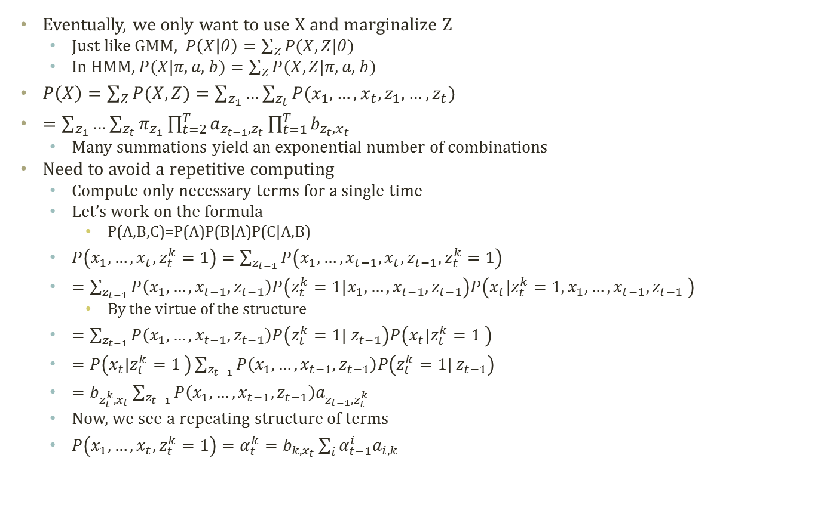

Marginal Probability
Initial State probabilities
$$P(z_{1})∼Mult(π_{1},…,π_{k})$$
Transition probabilities
$$P(z_{t}|z_{t−1}^{i}=1)∼Mult(a_{i,1},…,a_{i,k})$$
Or, $P\left(z_{t}^{j}=1 | z_{t−1}^{i}=1\right)=a_{i,j}$
Emission probabilities
$$P\left(x_{t} | z_{t}^{i}=1\right)∼Mult\left(b_{i,1},…,b_{i,m}\right)$$
Or, $P\left(x_{t}^{j}=1 | z_{t}^{i}=1\right)=b_{i,j}$
LLLLLLLFFFFFFFF
12342531643242
……………
FFFLLFLFLFLLLLFLLLFL
3526152436152436152
N
seq.
M_{i} observations for i-th sequence
Eventually, we only want to use X and marginalize Z
Just like GMM, $P\left(X | θ\right)=\sum_{Z}{P(X,Z|θ)}$
In HMM, $P(X|π\text{, }a\text{, }b)=\sum_{Z}{P(X,Z|π\text{, }a\text{, }b)}$
$P\left(X\right)=\sum_{Z}{P(X,Z)}=\sum_{z_{1}}{…\sum_{z_{t}}{P(x_{1},…,x_{t},z_{1},…,z_{t})}}$
$=\sum_{z_{1}}{…\sum_{z_{t}}{π_{z_{1}}\prod_{t=2}^{T}{a_{z_{t−1},z_{t}}}\prod_{t=1}^{T}{b_{z_{t},x_{t}}}}}$
Many summations yield an exponential number of combinations
Need to avoid a repetitive computing
Compute only necessary terms for a single time
Let’s work on the formula
P(A,B,C)=P(A)P(B|A)P(C|A,B)
$P\left(x_{1},…,x_{t}, z_{t}^{k}=1\right)=\sum_{z_{t−1}}{P\left(x_{1},…,x_{t−1},x_{t},z_{t−1},z_{t}^{k}=1\right)}$
$=\sum_{z_{t−1}}{P\left(x_{1},…,x_{t−1}, z_{t−1}\right)P\left(z_{t}^{k}=1|x_{1},…,x_{t−1}, z_{t−1}\right)P\left(x_{t}|z_{t}^{k}=1, x_{1},…,x_{t−1},z_{t−1} \right)}$
By the virtue of the structure
$=\sum_{z_{t−1}}{P\left(x_{1},…,x_{t−1}, z_{t−1}\right)P\left(z_{t}^{k}=1| z_{t−1}\right)P\left(x_{t}|z_{t}^{k}=1 \right)}$
$=P\left(x_{t}|z_{t}^{k}=1 \right)\sum_{z_{t−1}}{P\left(x_{1},…,x_{t−1}, z_{t−1}\right)P\left(z_{t}^{k}=1| z_{t−1}\right)}$
$=b_{z_{t}^{k},x_{t}}\sum_{z_{t−1}}{P\left(x_{1},…,x_{t−1}, z_{t−1}\right)a_{z_{t−1},z_{t}^{k}}}$
Now, we see a repeating structure of terms
$P\left(x_{1},…,x_{t}, z_{t}^{k}=1\right)=α_{t}^{k}=b_{k,x_{t}}\sum_{i}{α_{t−1}^{i}a_{i,k}}$
$$π$$
z1
z2
z3
x1
x2
x3

Slide 11
Detour: Dynamic Programming
F(4)
Dynamic programming:
A general algorithm design technique for solving problems defined by or formulated as recurrences with overlapping sub-instances
In this context, Programming == Planning
Main storyline
Setting up a recurrence
Relating a solution of a larger instance to solutions of some smaller instances
Solve small instances once
Record solutions in a table
Extract a solution of a larger instance from the table
F(3)
F(2)
F(2)
F(1)
F(1)
F(1)
F(0)
F(0)
Instance | Solution
F(0) | 0
F(1) | 1
F(2) | 1
F(3) | 2
F(4) | ?

Slide 12
Detour: Memoization
Key technique of dynamic programming
Simply put
Storing the results of previous function calls to reuse the results again in the future
More philosophical sense
Bottom-up approach for problem-solving
Recursion: Top-down of divide and conquer
Dynamic programming: Bottom-up of storing and building
Stackframe
Memoization
F(4)
Recursion
Instance | Solution
F(0) | 0
F(1) | 1
F(2) | 1
F(3) | 2
F(4) | 3
F(3)
F(2)
Dynamic Programming
n
2
R.A
F(2)
F(1)
n
3
F(1)
F(1)
F(0)
R.A
n
4
F(0)
R.A

Slide 13

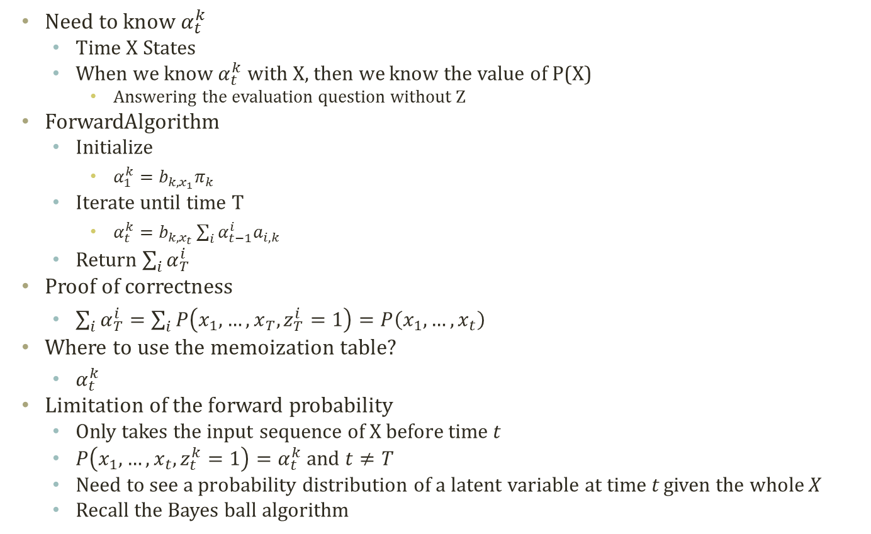
Forward Probability Calculation
Need to know $α_{t}^{k}$
Time X States
When we know $α_{t}^{k}$ with X, then we know the value of P(X)
Answering the evaluation question without Z
ForwardAlgorithm
Initialize
$α_{1}^{k}=b_{k,x_{1}}π_{k}$
Iterate until time T
$α_{t}^{k}=b_{k,x_{t}}\sum_{i}{α_{t−1}^{i}a_{i,k}}$
Return $\sum_{i}{α_{T}^{i}}$
Proof of correctness
$\sum_{i}{α_{T}^{i}}=\sum_{i}{P\left(x_{1},…,x_{T}, z_{T}^{i}=1\right)}=P\left(x_{1},…,x_{t}\right)$
Where to use the memoization table?
$α_{t}^{k}$
Limitation of the forward probability
Only takes the input sequence of X before time t
$P\left(x_{1},…,x_{t}, z_{t}^{k}=1\right)=α_{t}^{k}$ and $t≠T$
Need to see a probability distribution of a latent variable at time t given the whole X
Recall the Bayes ball algorithm
Iteration Direction == Forward
$$π$$
z1
z2
z3
x1
x2
x3

Slide 14

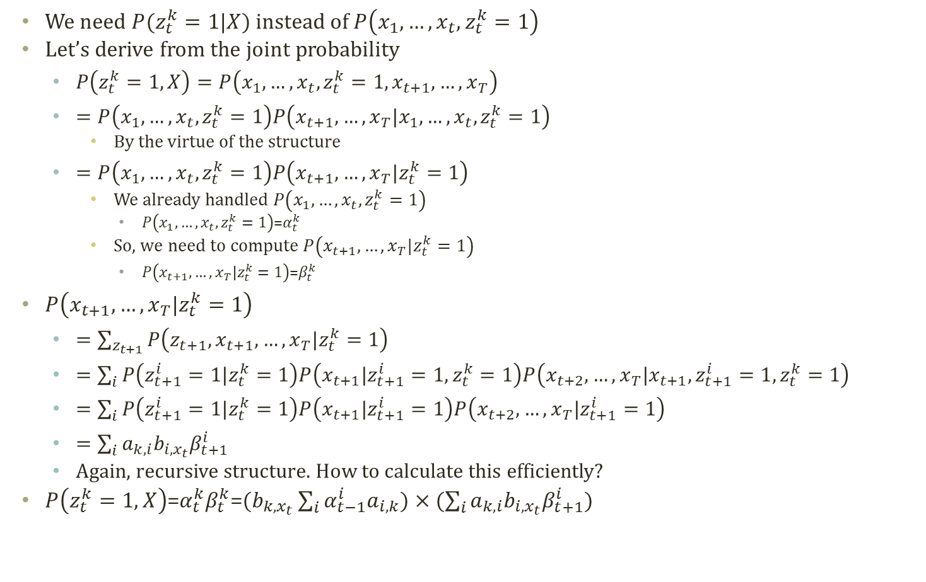
Backward Probability Calculation
We need $P(z_{t}^{k}=1|X)$ instead of $P\left(x_{1},…,x_{t}, z_{t}^{k}=1\right)$
Let’s derive from the joint probability
$P\left(z_{t}^{k}=1,X\right)=P\left(x_{1},…,x_{t},z_{t}^{k}=1,x_{t+1},…,x_{T}\right)$
$=P\left(x_{1},…,x_{t},z_{t}^{k}=1\right)P\left(x_{t+1},…,x_{T}|x_{1},…,x_{t},z_{t}^{k}=1\right)$
By the virtue of the structure
$=P\left(x_{1},…,x_{t},z_{t}^{k}=1\right)P\left(x_{t+1},…,x_{T}|z_{t}^{k}=1\right)$
We already handled $P\left(x_{1},…,x_{t},z_{t}^{k}=1\right)$
$P\left(x_{1},…,x_{t},z_{t}^{k}=1\right)$=$α_{t}^{k}$
So, we need to compute $P\left(x_{t+1},…,x_{T}|z_{t}^{k}=1\right)$
$P\left(x_{t+1},…,x_{T}|z_{t}^{k}=1\right)\text{=}β_{t}^{k}$
$P\left(x_{t+1},…,x_{T}|z_{t}^{k}=1\right)$
$=\sum_{z_{t+1}}{P\left(z_{t+1},x_{t+1},…,x_{T}|z_{t}^{k}=1\right)}$
$=\sum_{i}{P\left(z_{t+1}^{i}=1|z_{t}^{k}=1\right)P\left(x_{t+1}|z_{t+1}^{i}=1,z_{t}^{k}=1\right)P\left(x_{t+2},…,x_{T}|x_{t+1},z_{t+1}^{i}=1,z_{t}^{k}=1\right)}$
$=\sum_{i}{P\left(z_{t+1}^{i}=1|z_{t}^{k}=1\right)P\left(x_{t+1}|z_{t+1}^{i}=1\right)P\left(x_{t+2},…,x_{T}|z_{t+1}^{i}=1\right)}$
$=\sum_{i}{a_{k,i}b_{i,x_{t}}β_{t+1}^{i}}$
Again, recursive structure. How to calculate this efficiently?
$P\left(z_{t}^{k}=1,X\right)$=$α_{t}^{k}β_{t}^{k}$=$(b_{k,x_{t}}\sum_{i}{α_{t−1}^{i}a_{i,k}})×(\sum_{i}{a_{k,i}b_{i,x_{t}}β_{t+1}^{i}})$
Iteration Direction == Backward
$$π$$
z1
z2
z3
x1
x2
x3

Slide 15

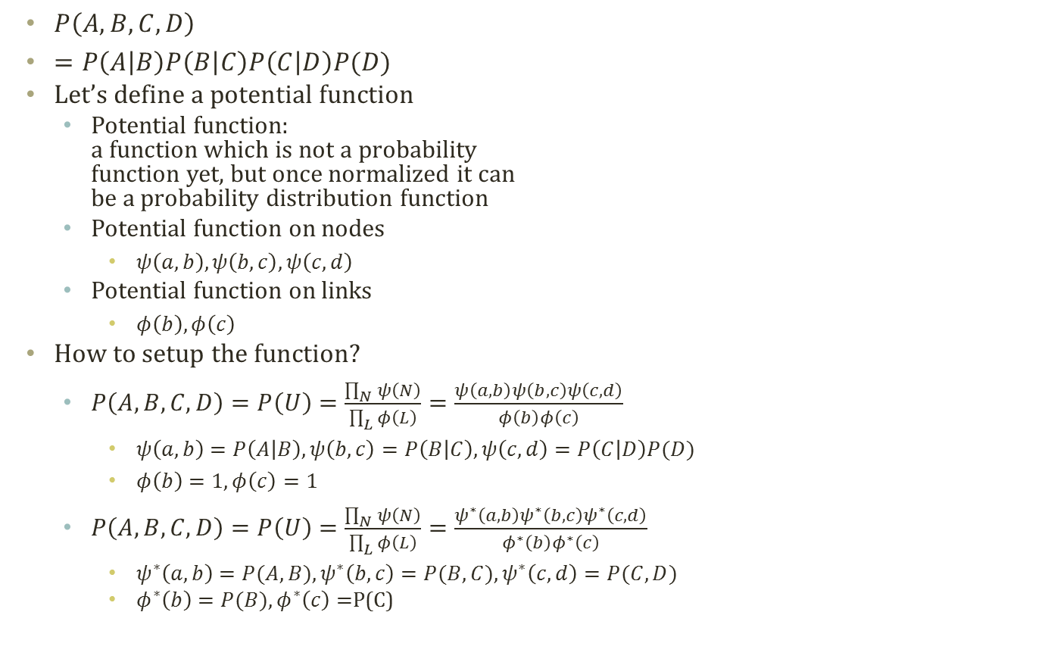
Detour: Potential Functions
$P\left(A,B,C,D\right)$
$=P\left(A | B\right)P\left(B | C\right)P\left(C | D\right)P(D)$
Let’s define a potential function
Potential function: a function which is not a probability function yet, but once normalized it can be a probability distribution function
Potential function on nodes
$ψ\left(a,b\right),ψ\left(b,c\right),ψ\left(c,d\right)$
Potential function on links
$φ\left(b\right),φ\left(c\right)$
How to setup the function?
$P\left(A,B,C,D\right)=P\left(U\right)=\frac{\prod_{N}{ψ\left(N\right)}}{\prod_{L}{φ\left(L\right)}}=\frac{ψ\left(a,b\right)ψ\left(b,c\right)ψ\left(c,d\right)}{φ\left(b\right)φ\left(c\right)}$
$ψ\left(a,b\right)=P\left(A | B\right),ψ\left(b,c\right)=P\left(B | C\right),ψ\left(c,d\right)=P\left(C | D\right)P(D)$
$φ\left(b\right)=1,φ\left(c\right)=1$
$P\left(A,B,C,D\right)=P\left(U\right)=\frac{\prod_{N}{ψ\left(N\right)}}{\prod_{L}{φ\left(L\right)}}=\frac{ψ^{∗}\left(a,b\right)ψ^{∗}\left(b,c\right)ψ^{∗}\left(c,d\right)}{φ^{∗}\left(b\right)φ^{∗}\left(c\right)}$
$ψ^{∗}\left(a,b\right)=P(A,B),ψ^{∗}\left(b,c\right)=P(B,C),ψ^{∗}\left(c,d\right)=P(C,D)$
$φ^{∗}\left(b\right)=P(B),φ^{∗}\left(c\right)=$P(C)
A
B
C
D
A,B
B
B,C
C
C,D
Clique
Separator
Marginalization is also applicable:
$$ψ\left(w\right)=\sum_{v−w}{ψ\left(v\right)}$$
Constructing a potential of a subset (w) of all variables (v)

Slide 16
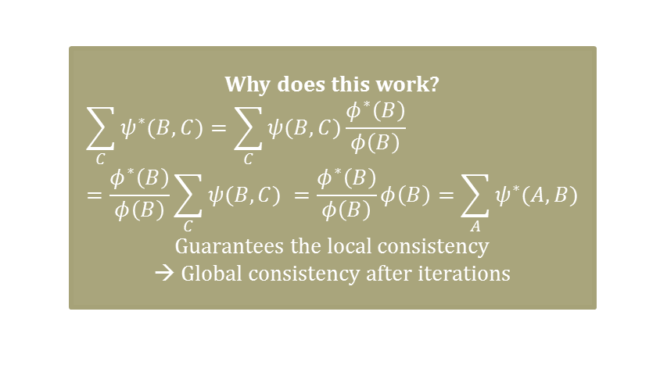
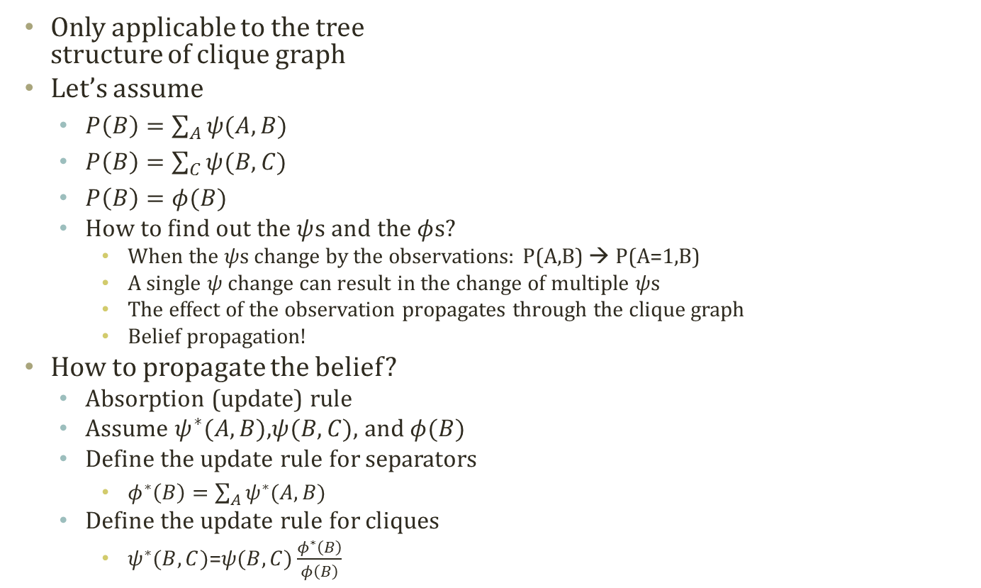
Detour: Absorption in Clique Graph
A
B
C
D
Only applicable to the tree structure of clique graph
Let’s assume
$P\left(B\right)=\sum_{A}{ψ(A,B)}$
$P\left(B\right)=\sum_{C}{ψ(B,C)}$
$P\left(B\right)=φ(B)$
How to find out the $ψ$s and the $φ$s?
When the $ψ$s change by the observations: P(A,B) → P(A=1,B)
A single $ψ$ change can result in the change of multiple $ψ$s
The effect of the observation propagates through the clique graph
Belief propagation!
How to propagate the belief?
Absorption (update) rule
Assume $ψ^{∗}(A,B)$,$ψ(B,C)$, and $φ(B)$
Define the update rule for separators
$φ^{∗}\left(B\right)=\sum_{A}{ψ^{∗}(A,B)}$
Define the update rule for cliques
$ψ^{∗}(B,C)$=$ψ(B,C)\frac{φ^{∗}\left(B\right)}{φ\left(B\right)}$
A,B
B
B,C
C
C,D
Why does this work?
$$\sum_{C}{ψ^{∗}(B,C)}=\sum_{C}{ψ(B,C)\frac{φ^{∗}\left(B\right)}{φ\left(B\right)}}=\frac{φ^{∗}\left(B\right)}{φ\left(B\right)}\sum_{C}{ψ(B,C) }=\frac{φ^{∗}\left(B\right)}{φ\left(B\right)}φ\left(B\right)=\sum_{A}{ψ^{∗}(A,B)}$$
Guarantees the local consistency → Global consistency after iterations

Slide 17


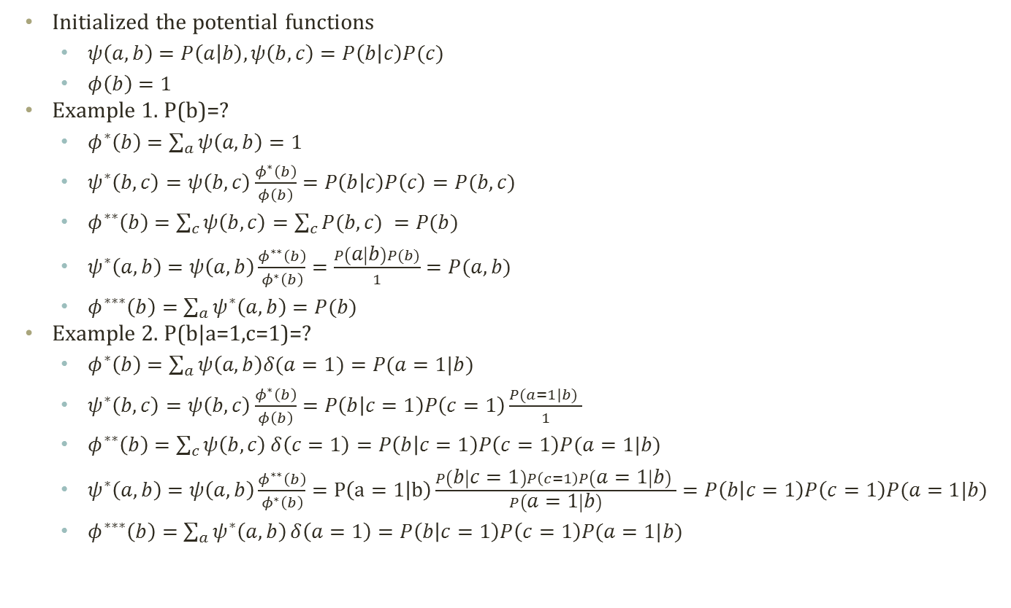



Detour: Simple Example of Belief Propagation
Initialized the potential functions
$ψ\left(a,b\right)=P\left(a | b\right),ψ\left(b,c\right)=P\left(b | c\right)P(c)$
$φ\left(b\right)=1$
Example 1. P(b)=?
$φ^{∗}\left(b\right)=\sum_{a}{ψ\left(a,b\right)}=1$
$ψ^{∗}\left(b,c\right)=ψ\left(b,c\right)\frac{φ^{∗}\left(b\right)}{φ\left(b\right)}=P\left(b | c\right)P\left(c\right)=P(b,c)$
$φ^{∗∗}\left(b\right)=\sum_{c}{ψ\left(b,c\right)}=\sum_{c}{P(b,c) }=P(b)$
$ψ^{∗}\left(a,b\right)=ψ\left(a,b\right)\frac{φ^{∗∗}\left(b\right)}{φ^{∗}\left(b\right)}=\frac{P\left(a | b\right)P(b)}{1}=P(a,b)$
$φ^{∗∗∗}\left(b\right)=\sum_{a}{ψ^{∗}\left(a,b\right)}=P(b)$
Example 2. P(b|a=1,c=1)=?
$φ^{∗}\left(b\right)=\sum_{a}{ψ\left(a,b\right)δ(a=1)}=P(a=1|b)$
$ψ^{∗}\left(b,c\right)=ψ\left(b,c\right)\frac{φ^{∗}\left(b\right)}{φ\left(b\right)}=P\left(b | c=1\right)P\left(c=1\right)\frac{P(a=1|b) }{1}$
$φ^{∗∗}\left(b\right)=\sum_{c}{ψ\left(b,c\right)}δ\left(c=1\right)=P\left(b | c=1\right)P\left(c=1\right)P(a=1|b)$
$ψ^{∗}\left(a,b\right)=ψ\left(a,b\right)\frac{φ^{∗∗}\left(b\right)}{φ^{∗}\left(b\right)}=P\left(a=1 | b\right)\frac{P\left(b | c=1\right)P\left(c=1\right)P\left(a=1 | b\right) }{P\left(a=1 | b\right)}=P\left(b | c=1\right)P\left(c=1\right)P(a=1|b)$
$φ^{∗∗∗}\left(b\right)=\sum_{a}{ψ^{∗}\left(a,b\right)}δ\left(a=1\right)=P\left(b | c=1\right)P\left(c=1\right)P(a=1|b)$
A
B
C
Bayesian Network
1) $φ^{∗}\left(b\right)$
2) $ψ^{∗}\left(b,c\right)$
4) $ψ^{∗}\left(a,b\right)$
3) $φ^{∗∗}\left(b\right)$
5) $φ^{∗∗∗}\left(b\right)$
A,B
B
B,C
Clique Graph

Slide 18
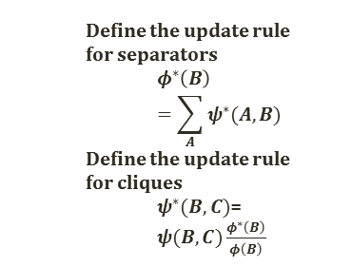
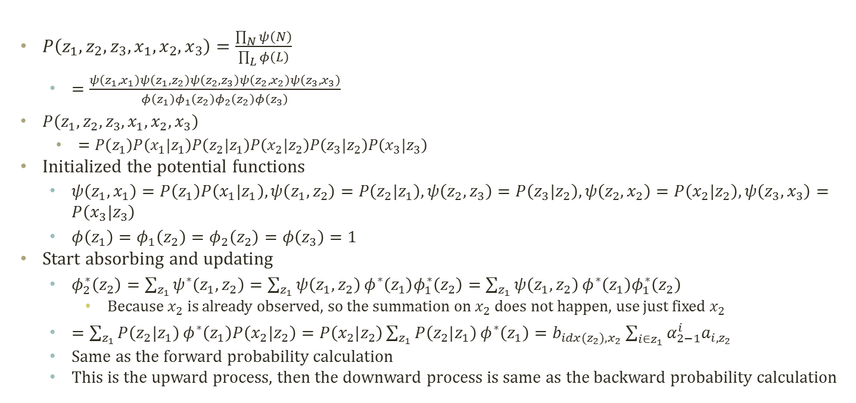



Message Passing and Forward-Backward
$$π$$
z1
z2
z3
z1, x1
z1
z1, z2
z2
z2, z3
$$φ_{2}\left(z_{2}\right)$$
$$φ_{1}\left(z_{2}\right)$$
z2
z3
x1
x2
x3
z2, x2
z3, x3
Define the update rule for separators
$$φ^{∗}\left(B\right)=\sum_{A}{ψ^{∗}(A,B)}$$
Define the update rule for cliques
$ψ^{∗}(B,C)$=$ψ(B,C)\frac{φ^{∗}\left(B\right)}{φ\left(B\right)}$
$P\left(z_{1},z_{2},z_{3},x_{1},x_{2},x_{3}\right)=\frac{\prod_{N}{ψ\left(N\right)}}{\prod_{L}{φ\left(L\right)}}$
$=\frac{ψ\left(z_{1},x_{1}\right)ψ\left(z_{1},z_{2}\right)ψ\left(z_{2},z_{3}\right)ψ\left(z_{2},x_{2}\right)ψ\left(z_{3},x_{3}\right)}{φ\left(z_{1}\right)φ_{1}\left(z_{2}\right)φ_{2}\left(z_{2}\right)φ\left(z_{3}\right)}$
$P\left(z_{1},z_{2},z_{3},x_{1},x_{2},x_{3}\right)$
$=P\left(z_{1}\right)P\left(x_{1}|z_{1}\right)P\left(z_{2}|z_{1}\right)P\left(x_{2}|z_{2}\right)P\left(z_{3}|z_{2}\right)P\left(x_{3}|z_{3}\right)$
Initialized the potential functions
$ψ\left(z_{1},x_{1}\right)=P\left(z_{1}\right)P\left(x_{1}|z_{1}\right),ψ\left(z_{1},z_{2}\right)=P\left(z_{2}|z_{1}\right),ψ\left(z_{2},z_{3}\right)=P\left(z_{3}|z_{2}\right),ψ\left(z_{2},x_{2}\right)=P\left(x_{2}|z_{2}\right),ψ\left(z_{3},x_{3}\right)=P\left(x_{3}|z_{3}\right)$
$φ\left(z_{1}\right)=φ_{1}\left(z_{2}\right)=φ_{2}\left(z_{2}\right)=φ\left(z_{3}\right)=1$
Start absorbing and updating
$φ_{2}^{∗}\left(z_{2}\right)=\sum_{z_{1}}{ψ^{∗}\left(z_{1},z_{2}\right)}=\sum_{z_{1}}{ψ\left(z_{1},z_{2}\right)}φ^{∗}\left(z_{1}\right)φ_{1}^{∗}\left(z_{2}\right)=\sum_{z_{1}}{ψ\left(z_{1},z_{2}\right)}φ^{∗}\left(z_{1}\right)φ_{1}^{∗}\left(z_{2}\right)$
Because $x_{2}$ is already observed, so the summation on $x_{2}$ does not happen, use just fixed $x_{2}$
$=\sum_{z_{1}}{P\left(z_{2}|z_{1}\right)}φ^{∗}\left(z_{1}\right)P\left(x_{2}|z_{2}\right)=P\left(x_{2}|z_{2}\right)\sum_{z_{1}}{P\left(z_{2}|z_{1}\right)}φ^{∗}\left(z_{1}\right)=b_{idx(z_{2}),x_{2}}\sum_{i∈z_{1}}{α_{2−1}^{i}a_{i,z_{2}}}$
Same as the forward probability calculation
This is the upward process, then the downward process is same as the backward probability calculation
Initial State probabilities
$$P(z_{1})∼Mult(π_{1},…,π_{k})$$
Transition probabilities
$$P(z_{t}|z_{t−1}^{i}=1)∼Mult(a_{i,1},…,a_{i,k})$$
Or, $P\left(z_{t}^{j}=1 | z_{t−1}^{i}=1\right)=a_{i,j}$
Emission probabilities
$$P\left(x_{t} | z_{t}^{i}=1\right)∼Mult\left(b_{i,1},…,b_{i,m}\right)$$
Or, $P\left(x_{t}^{j}=1 | z_{t}^{i}=1\right)=b_{i,j}$

Slide 19
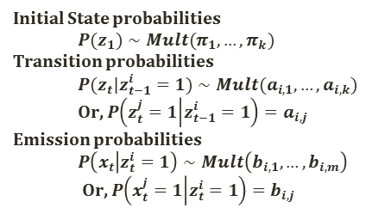
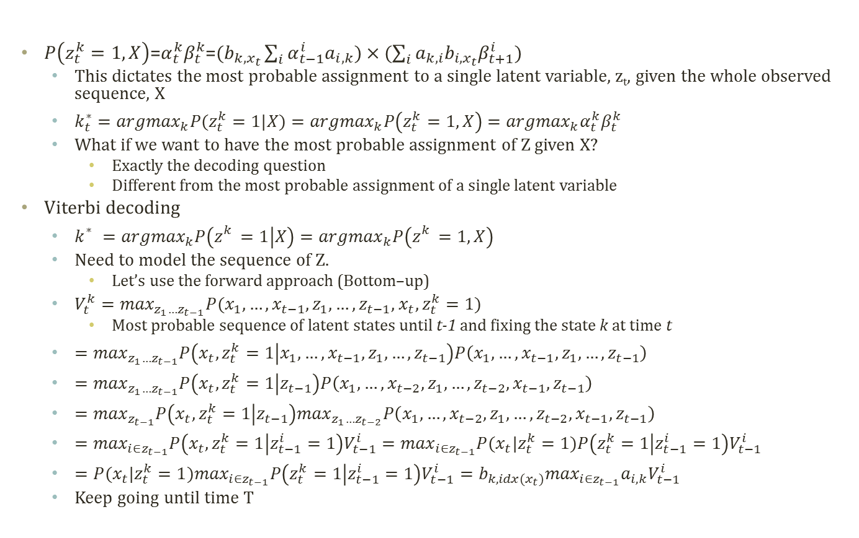
Viterbi Decoding
Initial State probabilities
$$P(z_{1})∼Mult(π_{1},…,π_{k})$$
Transition probabilities
$$P(z_{t}|z_{t−1}^{i}=1)∼Mult(a_{i,1},…,a_{i,k})$$
Or, $P\left(z_{t}^{j}=1 | z_{t−1}^{i}=1\right)=a_{i,j}$
Emission probabilities
$$P\left(x_{t} | z_{t}^{i}=1\right)∼Mult\left(b_{i,1},…,b_{i,m}\right)$$
Or, $P\left(x_{t}^{j}=1 | z_{t}^{i}=1\right)=b_{i,j}$
$P\left(z_{t}^{k}=1,X\right)$=$α_{t}^{k}β_{t}^{k}$=$(b_{k,x_{t}}\sum_{i}{α_{t−1}^{i}a_{i,k}})×(\sum_{i}{a_{k,i}b_{i,x_{t}}β_{t+1}^{i}})$
This dictates the most probable assignment to a single latent variable, z_{t}, given the whole observed sequence, X
$k_{t}^{∗}={argmax}_{k}P(z_{t}^{k}=1|X)={argmax}_{k}P\left(z_{t}^{k}=1,X\right)={argmax}_{k}α_{t}^{k}β_{t}^{k}$
What if we want to have the most probable assignment of Z given X?
Exactly the decoding question
Different from the most probable assignment of a single latent variable
Viterbi decoding
$k_{}^{∗}={argmax}_{k}P\left(z_{}^{k}=1 | X\right)={argmax}_{k}P\left(z_{}^{k}=1,X\right)$
Need to model the sequence of Z.
Let’s use the forward approach (Bottom–up)
$V_{t}^{k}=\max_{z_{1}…z_{t−1}}P(x_{1},…,x_{t−1},z_{1},…,z_{t−1}$, $x_{t},z_{t}^{k}=1)$
Most probable sequence of latent states until t-1 and fixing the state k at time t
$=\max_{z_{1}…z_{t−1}}P\left(x_{t},z_{t}^{k}=1 | x_{1},…,x_{t−1},z_{1},…,z_{t−1}\right)P\left(x_{1},…,x_{t−1},z_{1},…,z_{t−1}\right)$
$=\max_{z_{1}…z_{t−1}}P\left(x_{t},z_{t}^{k}=1 | z_{t−1}\right)P\left(x_{1},…,x_{t−2},z_{1},…,{z_{t−2},x}_{t−1},z_{t−1}\right)$
$=\max_{z_{t−1}}P\left(x_{t},z_{t}^{k}=1 | z_{t−1}\right)\max_{z_{1}…z_{t−2}}P\left(x_{1},…,x_{t−2},z_{1},…,{z_{t−2},x}_{t−1},z_{t−1}\right)$
$=\max_{i∈z_{t−1}}P\left(x_{t},z_{t}^{k}=1 | z_{t−1}^{i}=1\right)V_{t−1}^{i}=\max_{i∈z_{t−1}}P(x_{t}|z_{t}^{k}=1)P\left(z_{t}^{k}=1 | z_{t−1}^{i}=1\right)V_{t−1}^{i}$
$=P(x_{t}|z_{t}^{k}=1)\max_{i∈z_{t−1}}P\left(z_{t}^{k}=1 | z_{t−1}^{i}=1\right)V_{t−1}^{i}=b_{k,idx(x_{t})}\max_{i∈z_{t−1}}a_{i,k}V_{t−1}^{i}$
Keep going until time T

Slide 20

Detour: Assembly Line Scheduling
Assembly Line 1
station S_{1,1}
station S_{1,2}
station S_{1,3}
station S_{1,4}
station S_{1,5}
station S_{1,6}
7
9
3
4
8
4
2
1
3
4
3
2
3
Production Start
Production End
2
1
2
2
1
4
2
8
5
6
4
5
7
station S_{2,1}
station S_{2,2}
station S_{2,3}
station S_{2,4}
station S_{2,5}
station S_{2,6}
Assembly Line 2
Time Cost
Goal: Computing the fastest production route

Slide 21
Detour: Tracing Assembly Line Scheduling in DP
Assembly Line 1
station S_{1,1}
station S_{1,2}
station S_{1,3}
station S_{1,4}
station S_{1,5}
station S_{1,6}
7
9
3
4
8
4
2
1
3
4
3
2
3
Production Start
Production End
2
1
2
2
1
4
2
8
5
6
4
5
7
station S_{2,1}
station S_{2,2}
station S_{2,3}
station S_{2,4}
station S_{2,5}
station S_{2,6}
Assembly Line 2
Used for retrace purpose
Time | 1 | 2 | 3 | 4 | 5 | 6
L1 | 9 | 18 | 20 | 24 | 32 | 35
L2 | 12 | 16 | 22 | 25 | 30 | 37
Trace | 1 | 2 | 3 | 4 | 5 | 6
L1 | S | 1 | 2 | 1 | 1 | 2
L2 | S | 1 | 2 | 1 | 2 | 2

Slide 22
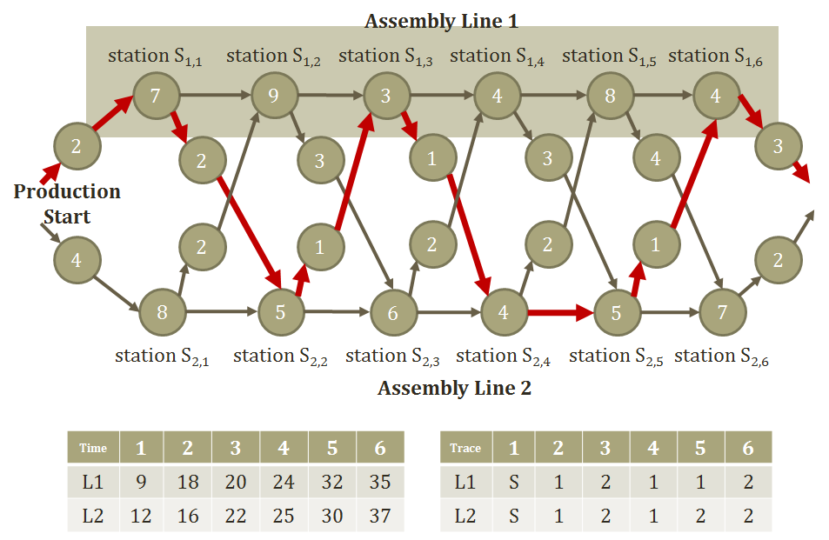

Viterbi Decoding Algorithm
Need to know$V_{t}^{k}$
Time X States
Store $V_{t}^{k}$Two variables to store the trace and the probability up to time t: Two memoization tables
Answering the decoding question with $π$, $a$, $b$, X
ViterbiDecodingAlgorithm
Initialize
$V_{1}^{k}=b_{k,x_{1}}π_{k}$
Iterate until time T
$V_{t}^{k}=b_{k,idx(x_{t})}\max_{i∈z_{t−1}}a_{i,k}V_{t−1}^{i}$
${trace}_{t}^{k}={argmax}_{i∈z_{t−1}}a_{i,k}V_{t−1}^{i}$
Return $P\left(X,Z^{∗}\right)=\max_{k}V_{T}^{k}$, $z_{T}^{∗}={argmax}_{k}V_{T}^{k}$, $z_{t−1}^{∗}={trace}_{t}^{z_{t}^{∗}}$
Technical difficulties in the implemtation
Very frequent underflow problems.
Turn this into the log domain → from multiplication to summation

Slide 23
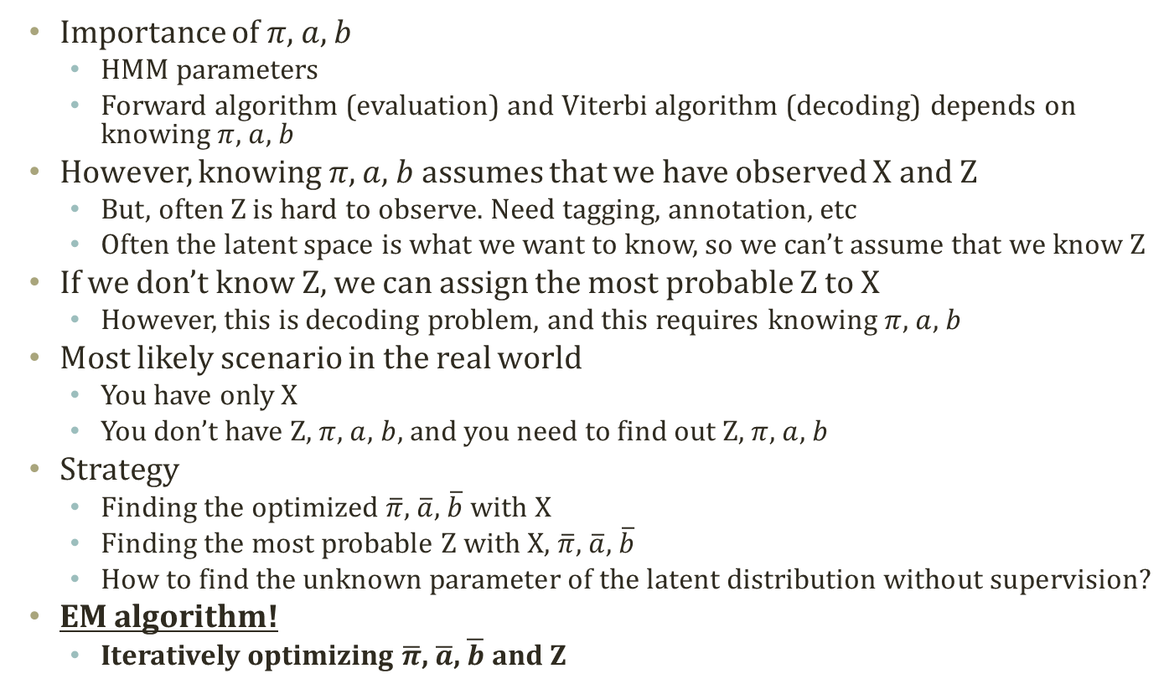
Learning Parameters with Only X
Importance of $π$, $a$, $b$
HMM parameters
Forward algorithm (evaluation) and Viterbi algorithm (decoding) depends on knowing $π$, $a$, $b$
However, knowing $π$, $a$, $b$ assumes that we have observed X and Z
But, often Z is hard to observe. Need tagging, annotation, etc
Often the latent space is what we want to know, so we can’t assume that we know Z
If we don’t know Z, we can assign the most probable Z to X
However, this is decoding problem, and this requires knowing $π$, $a$, $b$
Most likely scenario in the real world
You have only X
You don’t have Z, $π$, $a$, $b$, and you need to find out Z, $π$, $a$, $b$
Strategy
Finding the optimized $\overline{π}$, $\overline{a}$, $\overline{b}$ with X
Finding the most probable Z with X, $\overline{π}$, $\overline{a}$, $\overline{b}$
How to find the unknown parameter of the latent distribution without supervision?
EM algorithm!
Iteratively optimizing $\overline{π}$, $\overline{a}$, $\overline{b}$ and Z

Slide 24
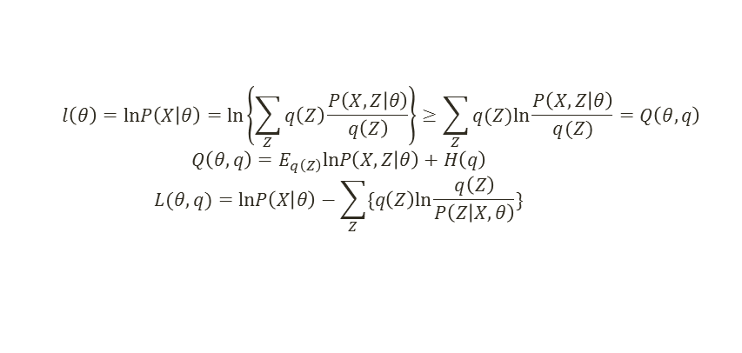
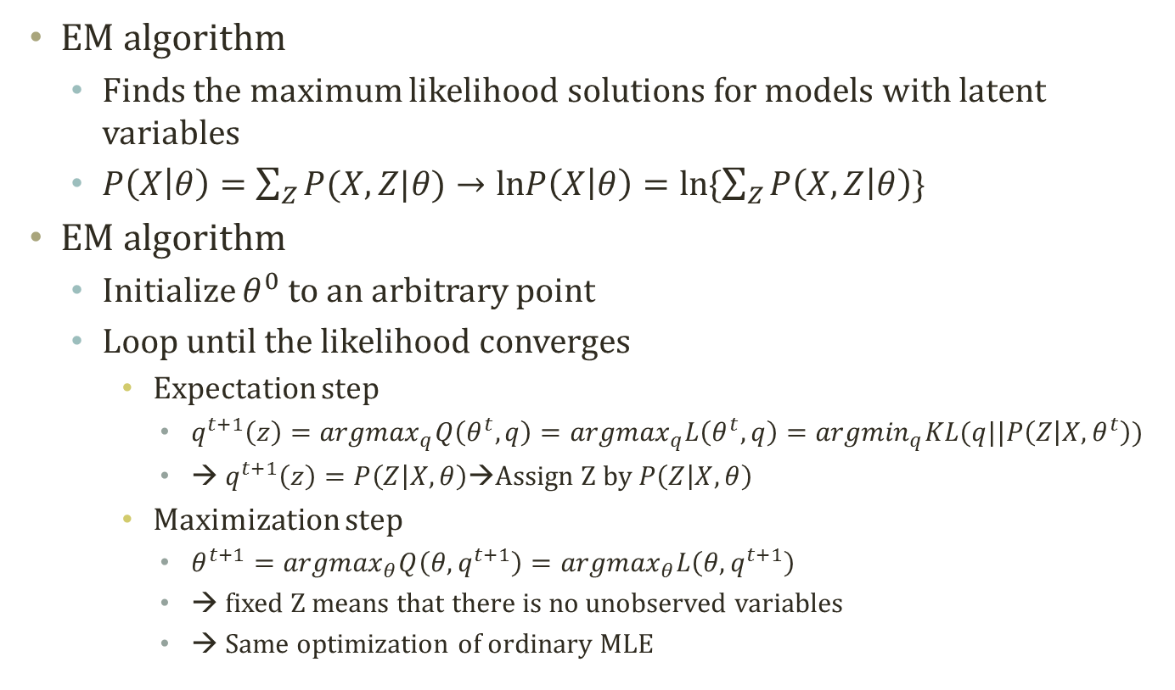
Detour: EM Algorithm
$$l\left(θ\right)=lnP\left(X | θ\right)=ln\left\{\sum_{Z}{q\left(Z\right)\frac{P\left(X,Z | θ\right)}{q\left(Z\right)}}\right\}≥\sum_{Z}{q(Z)ln\frac{P\left(X,Z | θ\right)}{q(Z)}}=Q\left(θ,q\right)$$
$$Q\left(θ,q\right)=E_{q\left(Z\right)}lnP\left(X,Z | θ\right)+H\left(q\right)$$
$$L(θ,q)=lnP\left(X | θ\right)−\sum_{Z}{\{q\left(Z\right)ln\frac{q\left(Z\right)}{P\left(Z | X,θ\right)}\}}$$
EM algorithm
Finds the maximum likelihood solutions for models with latent variables
$P\left(X | θ\right)=\sum_{Z}{P(X,Z|θ)}→lnP\left(X | θ\right)=ln\{\sum_{Z}{P\left(X,Z | θ\right)}\}$
EM algorithm
Initialize $θ^{0}$ to an arbitrary point
Loop until the likelihood converges
Expectation step
$q^{t+1}\left(z\right)={argmax}_{q}Q\left(θ^{t},q\right)={argmax}_{q}L\left(θ^{t},q\right)={argmin}_{q}KL(q||P\left(Z | X,θ^{t}\right))$
→ $q^{t+1}\left(z\right)=P\left(Z | X,θ\right)$→Assign Z by $P\left(Z | X,θ\right)$
Maximization step
$θ^{t+1}={argmax}_{θ}Q\left(θ,q^{t+1}\right)={argmax}_{θ}L\left(θ,q^{t+1}\right)$
→ fixed Z means that there is no unobserved variables
→ Same optimization of ordinary MLE

Slide 25
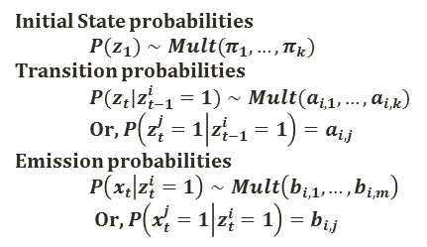
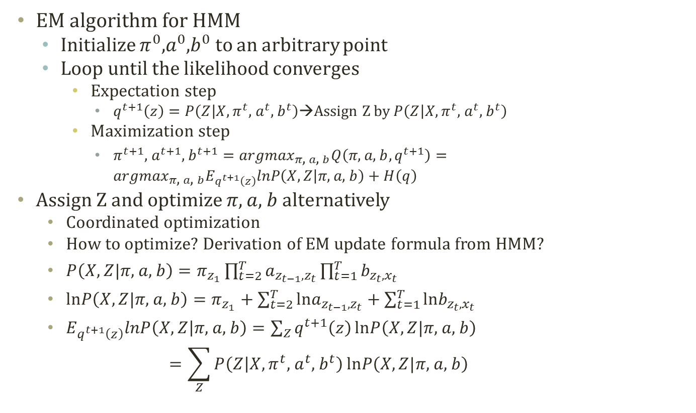
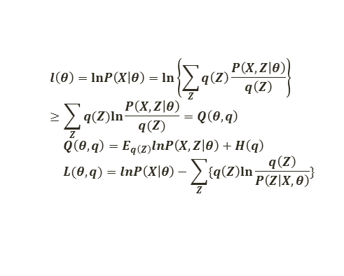
EM for HMM
$$l\left(θ\right)=lnP\left(X | θ\right)=ln\left\{\sum_{Z}{q\left(Z\right)\frac{P\left(X,Z | θ\right)}{q\left(Z\right)}}\right\}≥\sum_{Z}{q(Z)ln\frac{P\left(X,Z | θ\right)}{q(Z)}}=Q\left(θ,q\right)$$
$$Q\left(θ,q\right)=E_{q\left(Z\right)}lnP\left(X,Z | θ\right)+H\left(q\right)$$
$$L(θ,q)=lnP\left(X | θ\right)−\sum_{Z}{\{q\left(Z\right)ln\frac{q\left(Z\right)}{P\left(Z | X,θ\right)}\}}$$
Initial State probabilities
$$P(z_{1})∼Mult(π_{1},…,π_{k})$$
Transition probabilities
$$P(z_{t}|z_{t−1}^{i}=1)∼Mult(a_{i,1},…,a_{i,k})$$
Or, $P\left(z_{t}^{j}=1 | z_{t−1}^{i}=1\right)=a_{i,j}$
Emission probabilities
$$P\left(x_{t} | z_{t}^{i}=1\right)∼Mult\left(b_{i,1},…,b_{i,m}\right)$$
Or, $P\left(x_{t}^{j}=1 | z_{t}^{i}=1\right)=b_{i,j}$
EM algorithm for HMM
Initialize $π^{0}$,$a^{0}$,$b^{0}$ to an arbitrary point
Loop until the likelihood converges
Expectation step
$q^{t+1}\left(z\right)=P\left(Z | X,π^{t}\text{, }a^{t}\text{, }b^{t}\right)$→Assign Z by $P\left(Z | X,π^{t}\text{, }a^{t}\text{, }b^{t}\right)$
Maximization step
$π^{t+1}\text{, }a^{t+1}\text{, }b^{t+1}={argmax}_{π\text{, }a\text{, }b}Q\left(π\text{, }a\text{, }b,q^{t+1}\right)={argmax}_{π\text{, }a\text{, }b}E_{q^{t+1}\left(z\right)}lnP\left(X,Z | π\text{, }a\text{, }b\right)+H\left(q\right)$
Assign Z and optimize $π$, $a$, $b$ alternatively
Coordinated optimization
How to optimize? Derivation of EM update formula from HMM?
$P\left(X,Z|π\text{, }a\text{, }b\right)=π_{z_{1}}\prod_{t=2}^{T}{a_{z_{t−1},z_{t}}}\prod_{t=1}^{T}{b_{z_{t},x_{t}}}$
$lnP\left(X,Z|π\text{, }a\text{, }b\right)=π_{z_{1}}+\sum_{t=2}^{T}{lna_{z_{t−1},z_{t}}}+\sum_{t=1}^{T}{lnb_{z_{t},x_{t}}}$
$E_{q^{t+1}\left(z\right)}lnP\left(X,Z | π\text{, }a\text{, }b\right)=\sum_{Z}{q^{t+1}\left(z\right)}lnP\left(X,Z|π\text{, }a\text{, }b\right)$ $=\sum_{Z}{P\left(Z | X,π^{t}\text{, }a^{t}\text{, }b^{t}\right)}lnP\left(X,Z|π\text{, }a\text{, }b\right)$

Slide 26
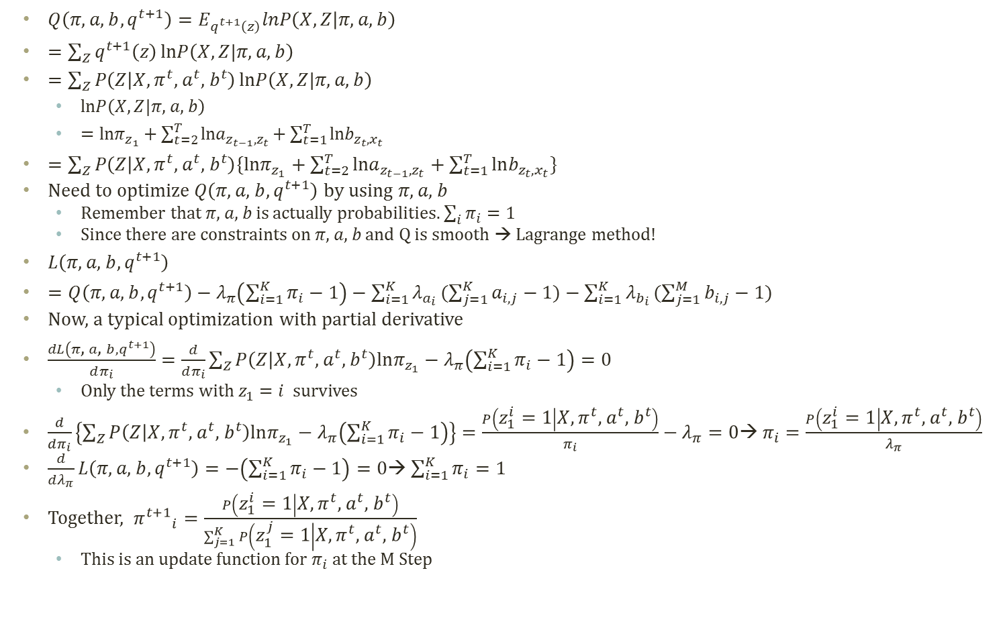

Derivation of EM Update Formula
Similarly, we can compute the update formula for a and b with the partial derivatives
$${a^{t+1}}_{i,j}=\frac{\sum_{t=2}^{T}{P\left(z_{t−1}^{i}=1,z_{t}^{j}=1 | X,π^{t}\text{, }a^{t}\text{, }b^{t}\right)}}{\sum_{t=2}^{T}{P\left(z_{t−1}^{i}=1 | X,π^{t}\text{, }a^{t}\text{, }b^{t}\right)}}$$
$${b^{t+1}}_{i,j}=\frac{\sum_{t=1}^{T}{P\left(z_{t}^{i}=1 | X,π^{t}\text{, }a^{t}\text{, }b^{t}\right)δ(idx(x_{t})=j)}}{\sum_{t=1}^{T}{P\left(z_{t}^{i}=1 | X,π^{t}\text{, }a^{t}\text{, }b^{t}\right)}}$$
$Q\left(π\text{, }a\text{, }b,q^{t+1}\right)=E_{q^{t+1}\left(z\right)}lnP\left(X,Z | π\text{, }a\text{, }b\right)$
$=\sum_{Z}{q^{t+1}\left(z\right)}lnP\left(X,Z|π\text{, }a\text{, }b\right)$
$=\sum_{Z}{P\left(Z | X,π^{t}\text{, }a^{t}\text{, }b^{t}\right)}lnP\left(X,Z|π\text{, }a\text{, }b\right)$
$lnP\left(X,Z|π\text{, }a\text{, }b\right)$
$=lnπ_{z_{1}}+\sum_{t=2}^{T}{lna_{z_{t−1},z_{t}}}+\sum_{t=1}^{T}{lnb_{z_{t},x_{t}}}$
$=\sum_{Z}{P\left(Z | X,π^{t}\text{, }a^{t}\text{, }b^{t}\right)\{lnπ_{z_{1}}+\sum_{t=2}^{T}{lna_{z_{t−1},z_{t}}}+\sum_{t=1}^{T}{lnb_{z_{t},x_{t}}}\}}$
Need to optimize $Q\left(π\text{, }a\text{, }b,q^{t+1}\right)$ by using $π\text{, }a\text{, }b$
Remember that $π\text{, }a\text{, }b$ is actually probabilities. $\sum_{i}{π_{i}}=1$
Since there are constraints on $π\text{, }a\text{, }b$ and Q is smooth → Lagrange method!
$L\left(π\text{, }a\text{, }b,q^{t+1}\right)$
$=Q\left(π\text{, }a\text{, }b,q^{t+1}\right)−λ_{π}\left(\sum_{i=1}^{K}{π_{i}}−1\right)−\sum_{i=1}^{K}{λ_{a_{i}}}(\sum_{j=1}^{K}{a_{i,j}}−1)−\sum_{i=1}^{K}{λ_{b_{i}}}(\sum_{j=1}^{M}{b_{i,j}}−1)$
Now, a typical optimization with partial derivative
$\frac{dL\left(π\text{, }a\text{, }b,q^{t+1}\right)}{dπ_{i}}=\frac{d}{dπ_{i}}\sum_{Z}{P\left(Z | X,π^{t}\text{, }a^{t}\text{, }b^{t}\right)lnπ_{z_{1}}}−λ_{π}\left(\sum_{i=1}^{K}{π_{i}}−1\right)=0$
Only the terms with $z_{1}=i$ survives
$\frac{d}{dπ_{i}}\left\{\sum_{Z}{P\left(Z | X,π^{t}\text{, }a^{t}\text{, }b^{t}\right)lnπ_{z_{1}}}−λ_{π}\left(\sum_{i=1}^{K}{π_{i}}−1\right)\right\}=\frac{P\left(z_{1}^{i}=1 | X,π^{t}\text{, }a^{t}\text{, }b^{t}\right)}{π_{i}}−λ_{π}=0$→ $π_{i}=\frac{P\left(z_{1}^{i}=1 | X,π^{t}\text{, }a^{t}\text{, }b^{t}\right)}{λ_{π}}$
$\frac{d}{dλ_{π}}L\left(π\text{, }a\text{, }b,q^{t+1}\right)=−\left(\sum_{i=1}^{K}{π_{i}}−1\right)=0$→ $\sum_{i=1}^{K}{π_{i}}=1$
Together, ${π^{t+1}}_{i}=\frac{P\left(z_{1}^{i}=1 | X,π^{t}\text{, }a^{t}\text{, }b^{t}\right)}{\sum_{j=1}^{K}{P\left(z_{1}^{j}=1 | X,π^{t}\text{, }a^{t}\text{, }b^{t}\right)}}$
This is an update function for $π_{i}$ at the M Step

Slide 27

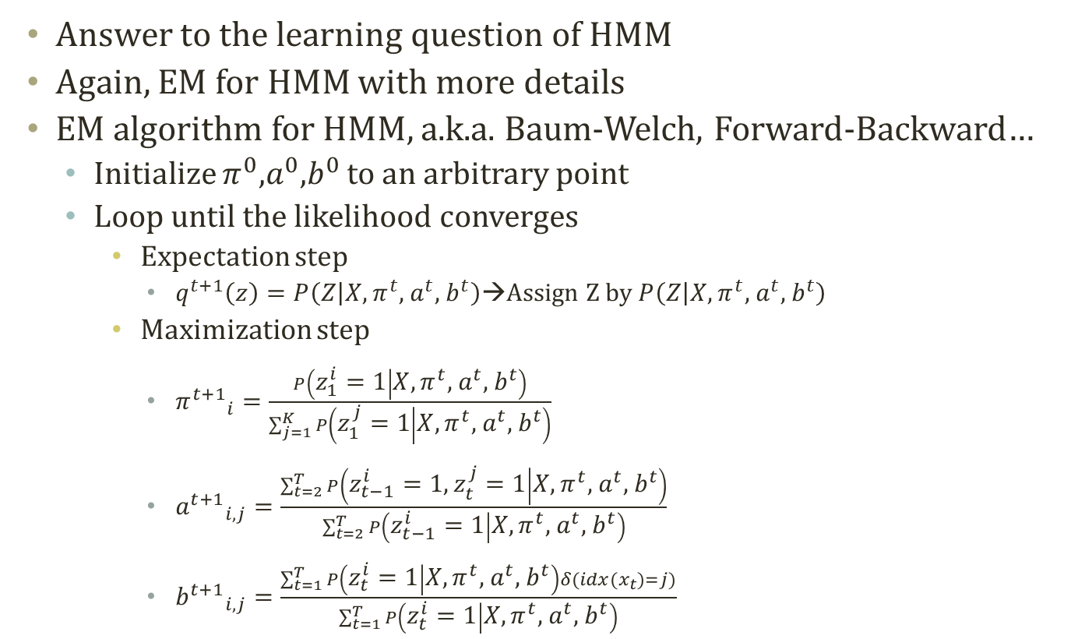

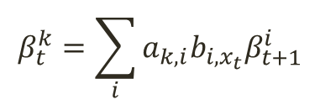
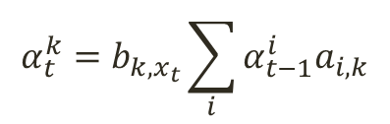
Baum Welch Algorithm
Answer to the learning question of HMM
Again, EM for HMM with more details
EM algorithm for HMM, a.k.a. Baum-Welch, Forward-Backward…
Initialize $π^{0}$,$a^{0}$,$b^{0}$ to an arbitrary point
Loop until the likelihood converges
Expectation step
$q^{t+1}\left(z\right)=P\left(Z | X,π^{t}\text{, }a^{t}\text{, }b^{t}\right)$→Assign Z by $P\left(Z | X,π^{t}\text{, }a^{t}\text{, }b^{t}\right)$
Maximization step
${π^{t+1}}_{i}=\frac{P\left(z_{1}^{i}=1 | X,π^{t}\text{, }a^{t}\text{, }b^{t}\right)}{\sum_{j=1}^{K}{P\left(z_{1}^{j}=1 | X,π^{t}\text{, }a^{t}\text{, }b^{t}\right)}}$
${a^{t+1}}_{i,j}=\frac{\sum_{t=2}^{T}{P\left(z_{t−1}^{i}=1,z_{t}^{j}=1 | X,π^{t}\text{, }a^{t}\text{, }b^{t}\right)}}{\sum_{t=2}^{T}{P\left(z_{t−1}^{i}=1 | X,π^{t}\text{, }a^{t}\text{, }b^{t}\right)}}$
${b^{t+1}}_{i,j}=\frac{\sum_{t=1}^{T}{P\left(z_{t}^{i}=1 | X,π^{t}\text{, }a^{t}\text{, }b^{t}\right)δ(idx(x_{t})=j)}}{\sum_{t=1}^{T}{P\left(z_{t}^{i}=1 | X,π^{t}\text{, }a^{t}\text{, }b^{t}\right)}}$
$P\left(z_{t}^{k}=1,X\right)$=$α_{t}^{k}β_{t}^{k}$
$$α_{t}^{k}=b_{k,x_{t}}\sum_{i}{α_{t−1}^{i}a_{i,k}}$$
$$β_{t}^{k}=\sum_{i}{a_{k,i}b_{i,x_{t}}β_{t+1}^{i}}$$
$$\text{P}\text{(}\text{X}\text{)=}\sum_{i}{α_{T}^{i}}$$

Slide 28
Acknowledgement
This slideset is greatly influenced
By Prof. Eric P. Xing at CMU

Slide 29
Further Readings
Bishop Chapter 13

